Slide 1
Lisa Fischer
Marcel Dux
Tilo Wendler
Student satisfaction determinants in hybrid learning environments
based on MAPLE
November, 2020

Slide 2
Intro and Agenda
~ 14,000 students
~ 2,000 Bachelor students in winter
1.)
Mathematics at
school
Mathematics at
university
2.) How we used Moebius
3.) Student‘s experience
MAPLE Conference 2020
Notes:
Tilo

Slide 3
Knowledge Gap & Challenges
Mathematics at
school
Mathematics at
university
MAPLE Conference 2020
Notes:
Tilo

Slide 4
Knowledge Gap & Challenges
Mathematics at
school
Mathematics at
university
Challenges
Student‘s level of expertise
Lack of deeper understanding
Practise math using case studies
MAPLE Conference 2020
Notes:
Tilo

Slide 5
Bridge Course Mathematics
Getting started in Moebius
Digital Placement Test
Online Lecture
Online
Tutorial
Online MAPLE Exercises
Final Digital Test
Moebius/MAPLE (self study)
Lecture & tutorials (digital meetings)
Twice a week for 4 weeks
Economics
2 Identical courses
12 Tutorials
Engineering and Computer Sciences
Identical courses
10 Tutorials
849 registrations
MAPLE Conference 2020

Slide 6
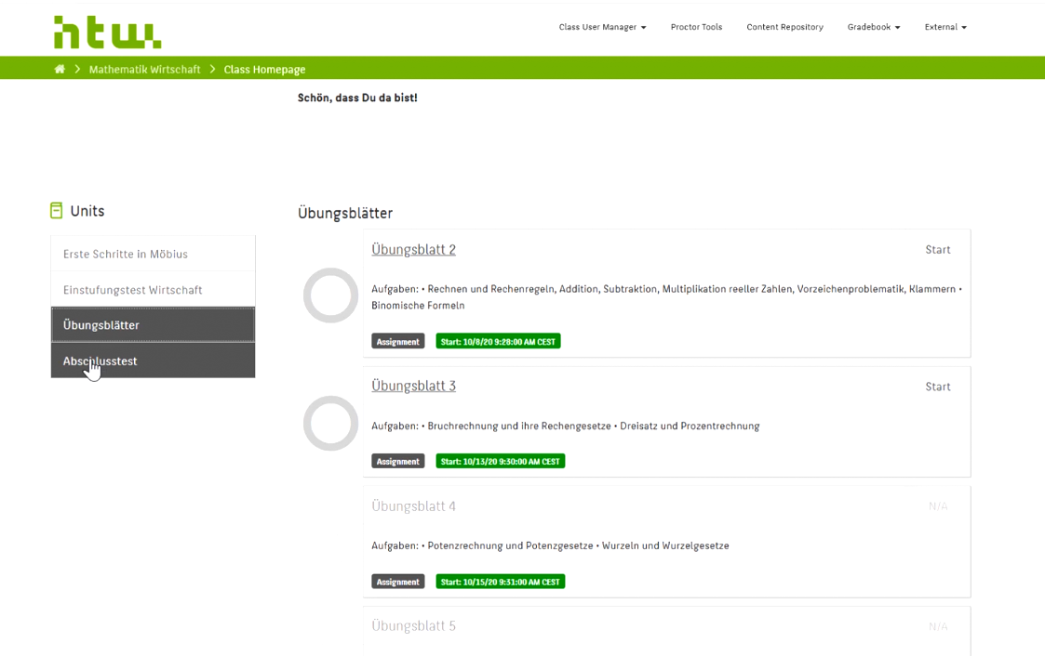
Possibilities in Moebius / MAPLE
https://t1p.de/moebius-htwberlin
MAPLE Conference 2020

Slide 7
Student‘s Experience
MAPLE Conference 2020

Slide 8
Student‘s Experience
MAPLE Conference 2020

Slide 9
Student‘s Experience
Good way for self-regulated learning
instant feedback perfect for individual reflection
usefully in combination with tutorials
MAPLE Conference 2020

Slide 10
Lessons Learned - Organization
Onboarding of the responsible persons
Increase willingness to use
Repository structure
important to integrate clear examples
early Onboarding for all staff-members
provide handbooks and tutorials
MAPLE Conference 2020
Notes:
Marcel

Slide 11
Lessons Learned - Moebius
Case studies
Consider real world problems
Repository structure
Classify exercises
→ find tasks easier
Quick start guide
MAPLE Conference 2020
Notes:
Repository structure
Integration Praxisbeipiele
Frühzeitiges Onboarding der Verantwortlichen, um die Nutzungsbereitschaft zu erhöhen
Bereitstellen von Handreichungen und Schulungen
Gute Verzahnung von Online-Durchführung und didaktischer Möglichkeiten
Admin Experience
Screenshot vom Handbook von Morgan

Slide 12
Lessons Learned - Moebius
Registration
Reduction of participation hurdles
Case studies
Consider real world problems
Privacy Policy
Depending on countries
Repository structure
Classify exercises
→ find tasks easier
Quick start guide
Profound know-how in MAPLE
Necessary to create content
MAPLE Conference 2020
Notes:
Repository structure
Integration Praxisbeipiele
Frühzeitiges Onboarding der Verantwortlichen, um die Nutzungsbereitschaft zu erhöhen
Bereitstellen von Handreichungen und Schulungen
Gute Verzahnung von Online-Durchführung und didaktischer Möglichkeiten
Admin Experience
Screenshot vom Handbook von Morgan

Slide 13
Summary
MAPLE used in a bridge course in mathematics
Student’s experience
Lessons Learned
MAPLE Conference 2020
Notes:
Marcel

Slide 14
Lisa Fischer
lisa.fischer@htw-berlin.de
Many thanks for your attention!
Marcel Dux
marcel.dux@htw-berlin.de
Tilo Wendler
vp.lehre@htw-berlin.de
MAPLE Conference 2020

Slide 15
Student satisfaction determinants in hybrid learning environments
Summary
Student‘s experience
MAPLE / Moebius
Good way for self-regulated learning
instant feedback perfect for individual reflection
usefully in combination with tutorials
Moebius is perfect for self-regulated learning, if ...
it exists a easy to use respository
Good combination between lessons and individual tutorials
specific examples from different special fields
Tilo Wendler, Marcel Dux, Lisa Fischer
MAPLE Conference 2020

